Slide 1
NBKR INSTITUTION OF
SCIENCE AND TECHNOLOGY
CLASSROOM SEAT ALLOCATOR
Using Data Structure In C
PRESENTED BY:
M.Sai Divya Reddy(5X9)
K.Nandhini(5T0)
M.Sruthi(5X4)
G.Sruthi(5K4)

Slide 2
Problem Statement
Seat students in a classroom such that no two students from same department are seated adjacent to each other(horizontally or vertically).
Example:
CSE ECE MECH EEE ECE MECH EEE CSE MECH EEE CSE ECE EEE CSE ECE MECH

Slide 3
Program Overview
A C program that takes classroom size and student information as input and attempts to seat students based on department constraints.
Bullet Points:
Takes classroom size(Rows and Columns)as input.
Takes strudent information(Rool nuber and Department)as input.
Prints the seating arrangement.

Slide 4
Algorithm
Input phase
Read the classroom size ( number of rows and columns).
Read the number of students
For each student: Read the roll number and department
.

Slide 5
Algorithm
Seating phase:
Intialize an empty classroom.
For each student:
Find a seat in the class room that satisfies the department constraint.
If such a seat is found,assign the student to that seat.
If no such a student is found,print a message indicating that the student cannot be seated.

Slide 6
Algorithm
Checking department constaints:
Check the adjacent seats(up,down,left and right).
Ensure that no two students from same department are seated adjacent to each other.
Output phase:
Print the final seating arrangement of the classroom.

Slide 7
Code snippets
isSafe():checks if a seat satisfies the department constraint.
seatStudents():seat students in the classroom based on the department constraint.
printClassroom():prints the final seating arrangement.

Slide 8
Input and output
Example input:
Classroom size:3x3
Number of students:5
Student information:roll number and department.
Example output:
Seating arrangement:
1(cse) | 2(ece) | 3(mech)
4(ece) | ----- | 6(cse)
----- | ----- | -----

Slide 9
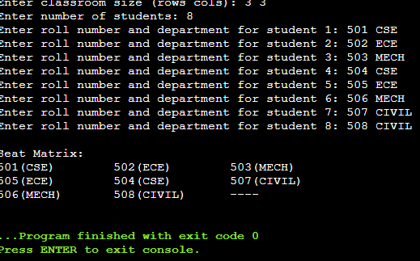
Source code

Slide 10
Conclusion
The program provides a basic solution to the problem of seating students in a classroom with department constraints.
Future work:
Improve the algorithm for better efficiency.
And more features to handle different types of constraints.

Slide 11
THANK YOU!

